Slide 1

Artificial Intelligence
Genetic algorithms
CS-632
Dr. Muhammad Aqib
University Institute of Information Technology
PMAS-Arid Agriculture University Rawalpindi

Slide 2
What Are Genetic Algorithms?
Genetic Algorithms (GAs) are adaptive heuristic search algorithm based on the evolutionary ideas of natural selection in genetics.
As such they represent an intelligent exploitation of a random search used to solve optimization problems.
Exploit historical information to search into the region of better performance within the search space.
Follow the principles first laid down by Charles Darwin of "survival of the fittest.". Since in nature, competition among individuals for scanty resources results in the fittest individuals dominating over the weaker ones.

Slide 3
Why Genetic Algorithms?
It is better than conventional AI in that it is more robust.
Unlike older AI systems, they do not break easily even if the inputs changed slightly, or in the presence of reasonable noise.
In large state-space, multi-modal state-space, or n-dimensional surface, a genetic algorithm may offer significant benefits over more typical search of optimization techniques. For example, linear programming, heuristic, depth-first, breadth-first.

Slide 4
Genetic Algorithms Overview
GAs simulate the survival of the fittest among individuals over consecutive generation for solving a problem.
Each generation consists of a population of character strings that are analogous to the chromosome that we see in our DNA.
Each individual represents a point in a search space and a possible solution. The individuals in the population are then made to go through a process of evolution.
GAs are based on an analogy with the genetic structure and behavior of chromosomes within a population of individuals using the following foundations:
Individuals in a population compete for resources and mates.
Successful individuals in each 'competition' will produce more offspring than those individuals that perform poorly.
Genes from `good' individuals propagate throughout the population so that two good parents will sometimes produce offspring that are better than either parent.
Thus, each successive generation will become more suited to their environment.

Slide 5
Implementation Details
After an initial population is randomly generated, the algorithm evolves through three operators:
Selection, which equates to survival of the fittest;
Crossover, which represents mating between individuals;
Mutation, which introduces random modifications.

Slide 6
Selection Operator
Key idea: give preference to better individuals, allowing them to pass on their genes to the next generation.
The goodness of each individual depends on its fitness.
Fitness may be determined by an objective function or by a subjective judgement.

Slide 7
Crossover Operator
Prime distinguished factor of GA from other optimization techniques
Two individuals are chosen from the population using the selection operator
A crossover site along the bit strings is randomly chosen
The values of the two strings are exchanged up to this point
If S1=000000 and S2=111111 and the crossover point is 2 then S1'=110000 and S2'=001111
The two new offspring created from this mating are put into the next generation of the population
By recombining portions of good individuals, this process is likely to create even better individuals

Slide 8
Crossover Operator (Cont.)
Order 1 Crossover is a fairly simple permutation crossover. Basically, a swath of consecutive alleles from parent 1 drops down, and remaining values are placed in the child in the order which they appear in parent 2.
Parent 1: 8 4 7 3 6 2 5 1 9 0
Parent 2: 0 1 2 3 4 5 6 7 8 9
Child 1: 0 4 7 3 6 2 5 1 8 9
Step 1: Select a random swath of consecutive alleles from parent 1. (underlined)
Step 2: Drop the swath down to Child 1 and mark out these alleles in Parent 2.
Step 3: Starting on the right side of the swath, grab alleles from parent 2 and insert them in Child 1 at the right edge of the swath. Since 8 is in that position in Parent 2, it is inserted into Child 1 first at the right edge of the swath. Notice that alleles 1, 2 and 3 are skipped because they are marked out and 4 is inserted into the 2nd spot in Child 1.
Step 4: If you desire a second child from the two parents, flip Parent 1 and Parent 2 and go back to Step 1.

Slide 9
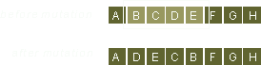
Mutation Operator
With some low probability, a portion of the new individuals will have some of their bits flipped.
Its purpose is to maintain diversity within the population and inhibit premature convergence.
Mutation alone induces a random walk through the search space
Mutation and selection (without crossover) create a parallel, noise-tolerant, hill-climbing algorithms

Slide 10
Effects of Genetic Operators
Using selection alone will tend to fill the population with copies of the best individual from the population.
Using selection and crossover operators will tend to cause the algorithms to converge on a good but sub-optimal solution.
Using mutation alone induces a random walk through the search space.
Using selection and mutation creates a parallel, noise-tolerant, hill climbing algorithm

Slide 11
The Algorithms
randomly initialize population(t)
determine fitness of population(t)
repeat
select parents from population(t)
perform crossover on parents creating population(t+1)
perform mutation of population(t+1)
determine fitness of population(t+1)
until best individual is good enough

Slide 12
Initial Population
https://www.youtube.com/watch?v=ejxfTy4lI6I
Notes:
https://www.youtube.com/watch?v=ejxfTy4lI6I

Slide 13
60 %

Slide 14
60 %
25 %
15 %

Slide 15
60 %
25 %
15 %

Slide 16
60 %
25 %
15 %

Slide 17
60 %
25 %
50 %
15 %

Slide 18


Slide 19
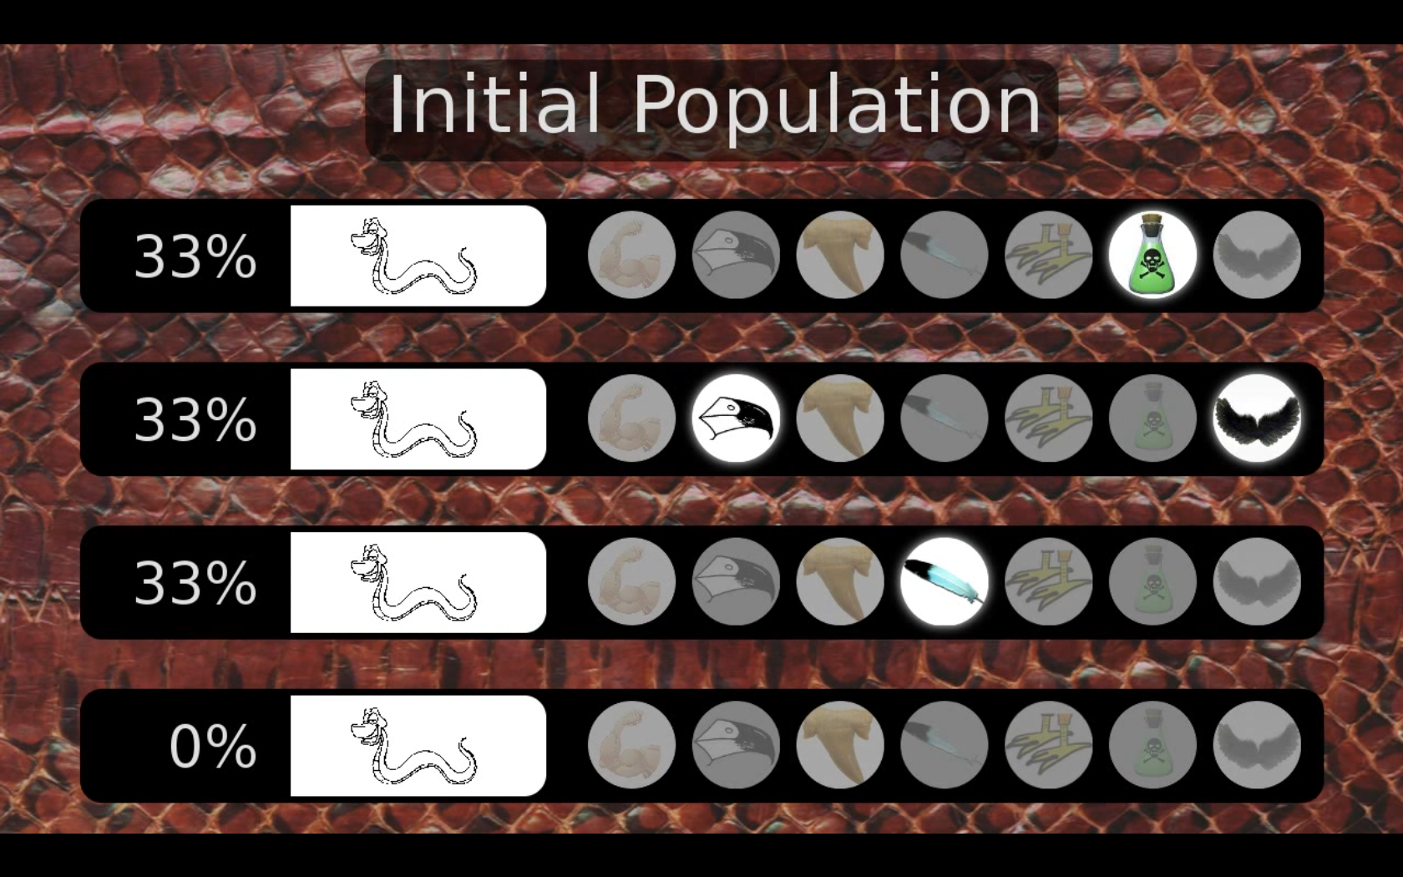

Slide 20
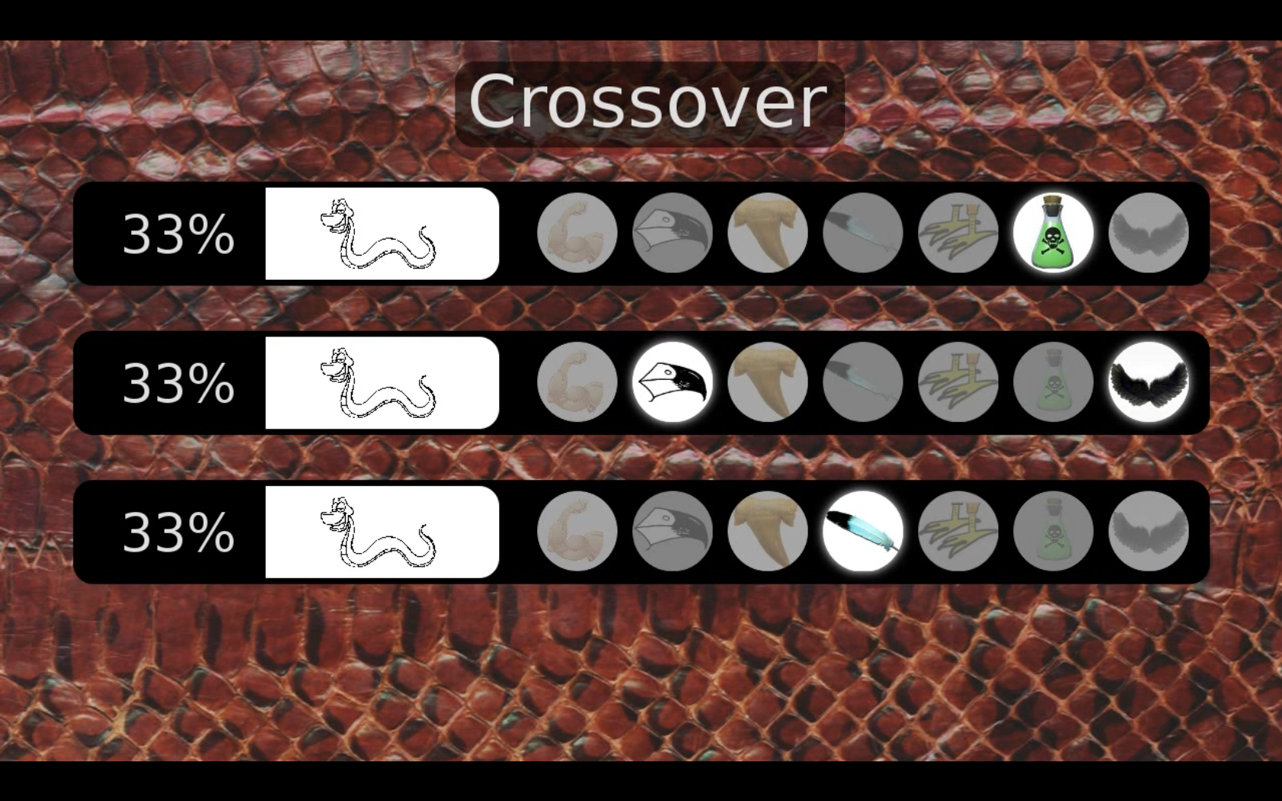

Slide 25
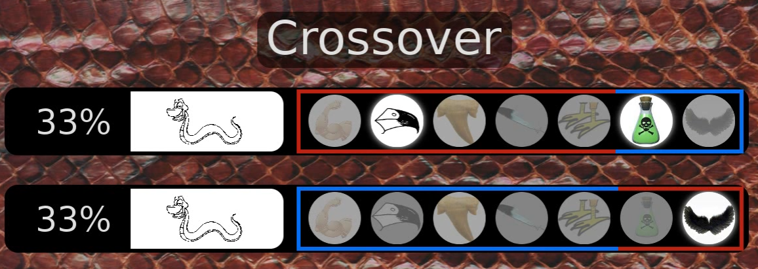

Slide 26
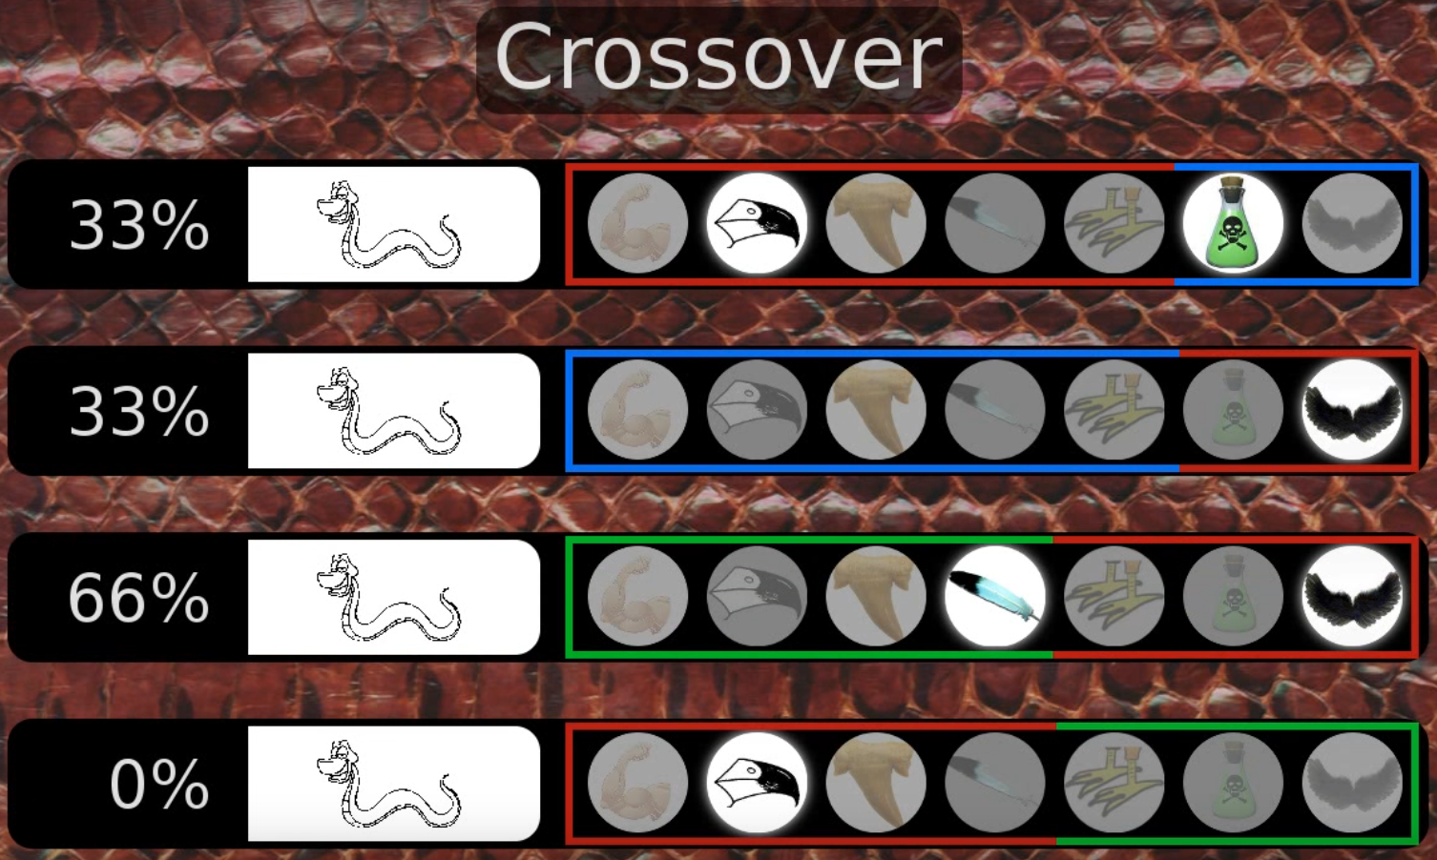

Slide 27
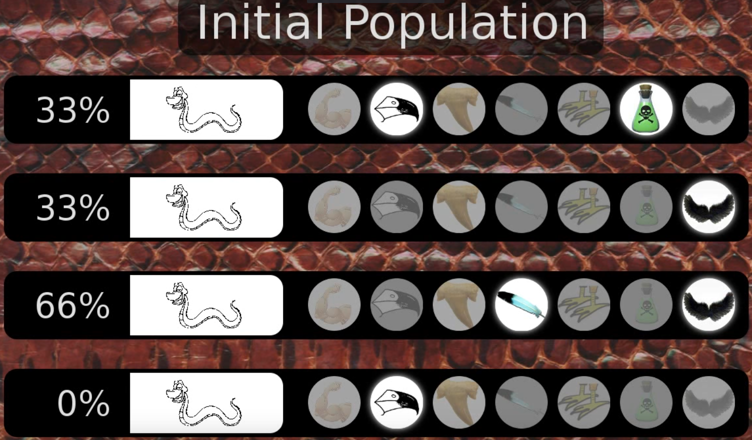

Slide 28
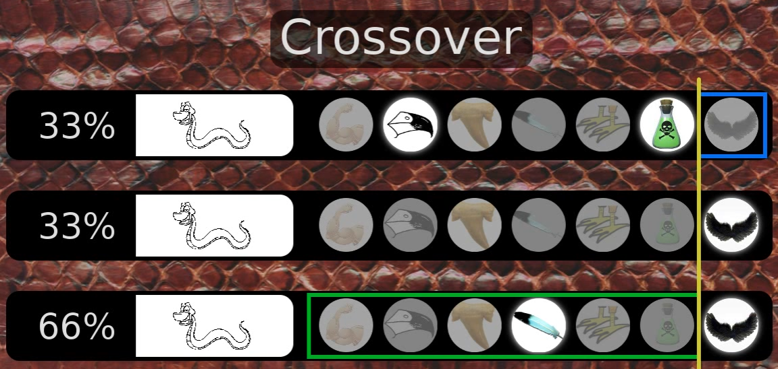

Slide 29
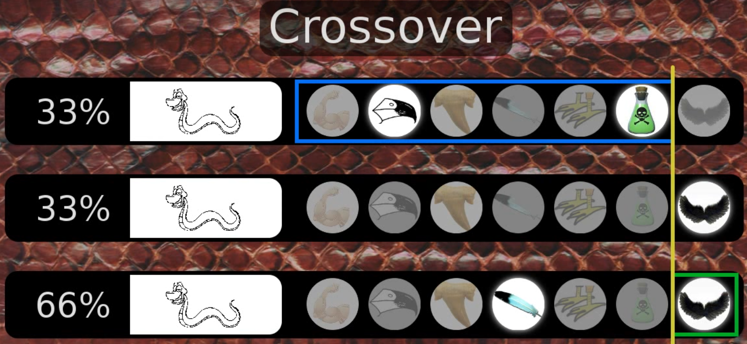

Slide 30
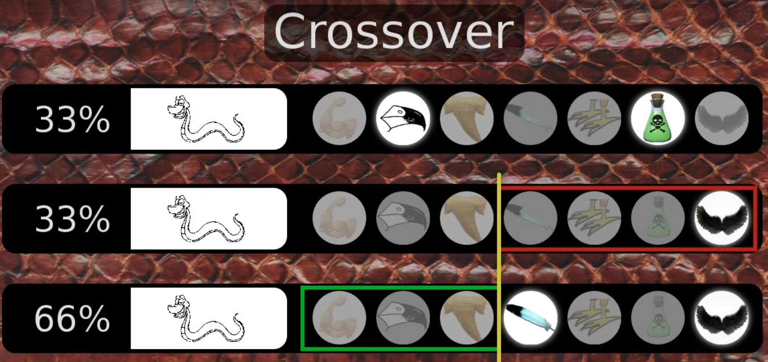

Slide 31
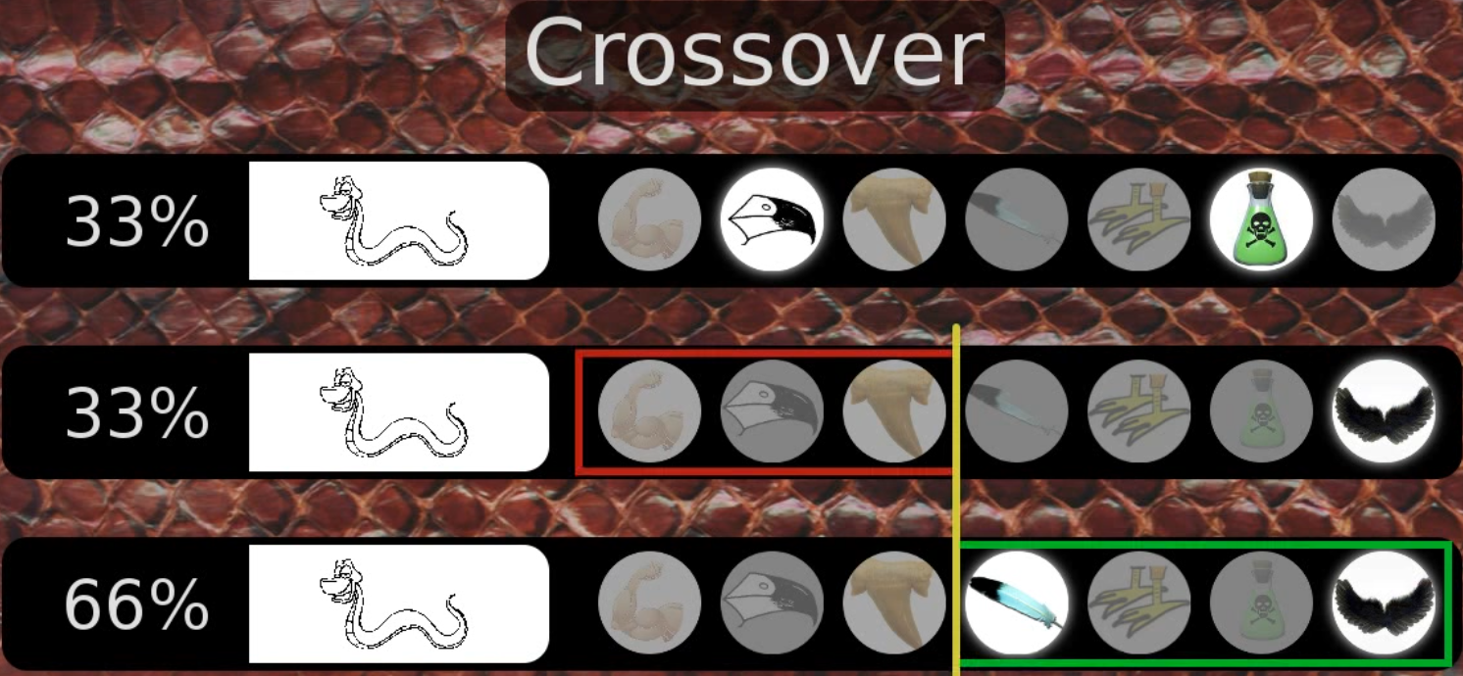

Slide 32
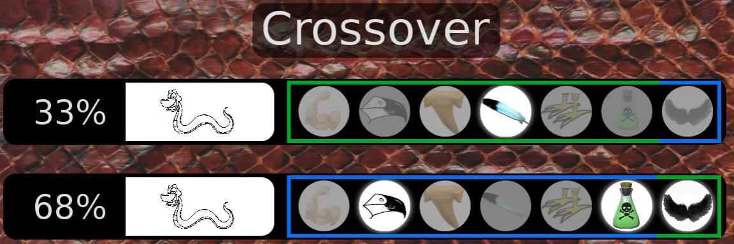

Slide 33
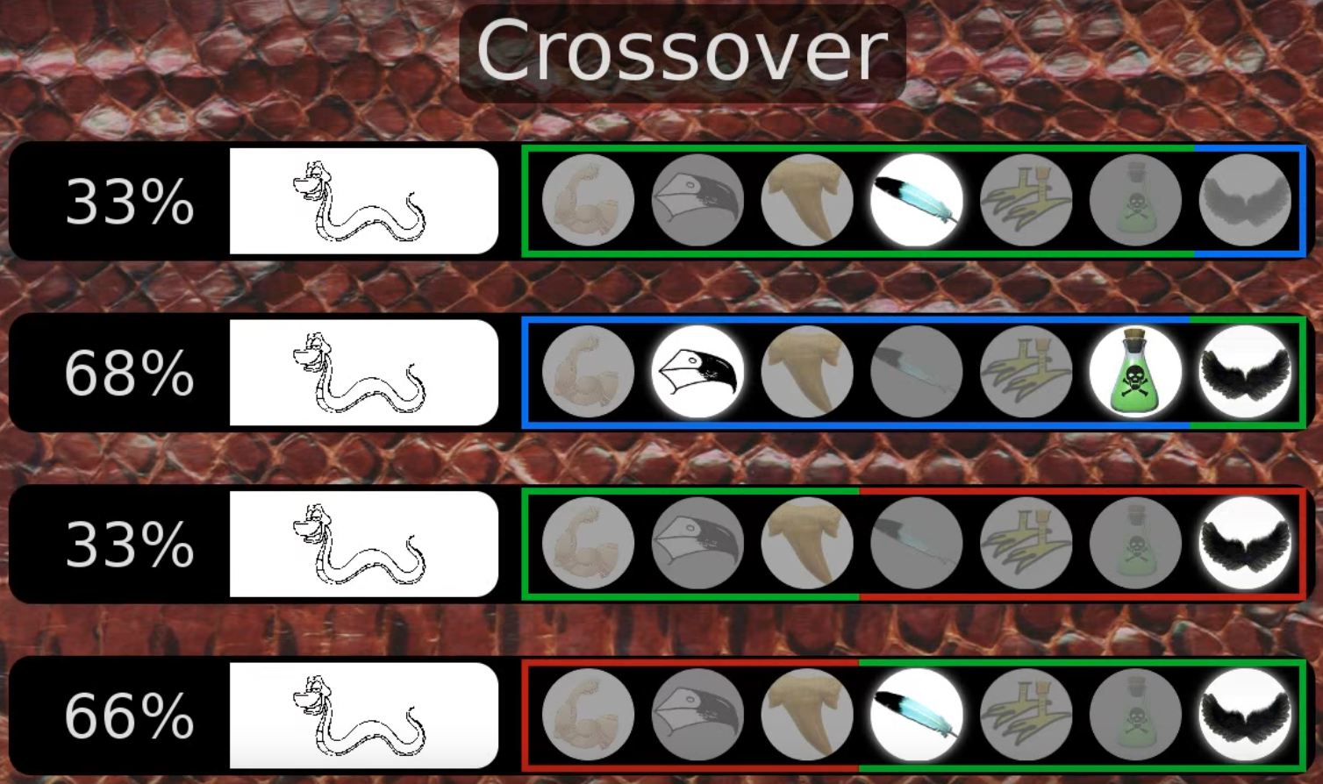

Slide 34
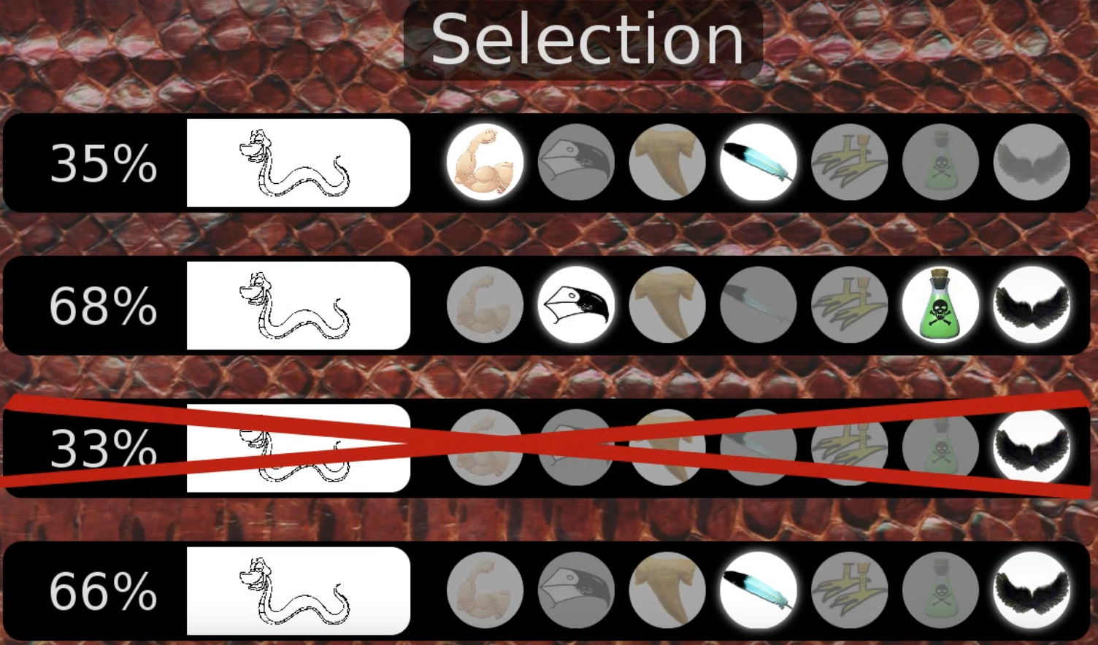

Slide 35
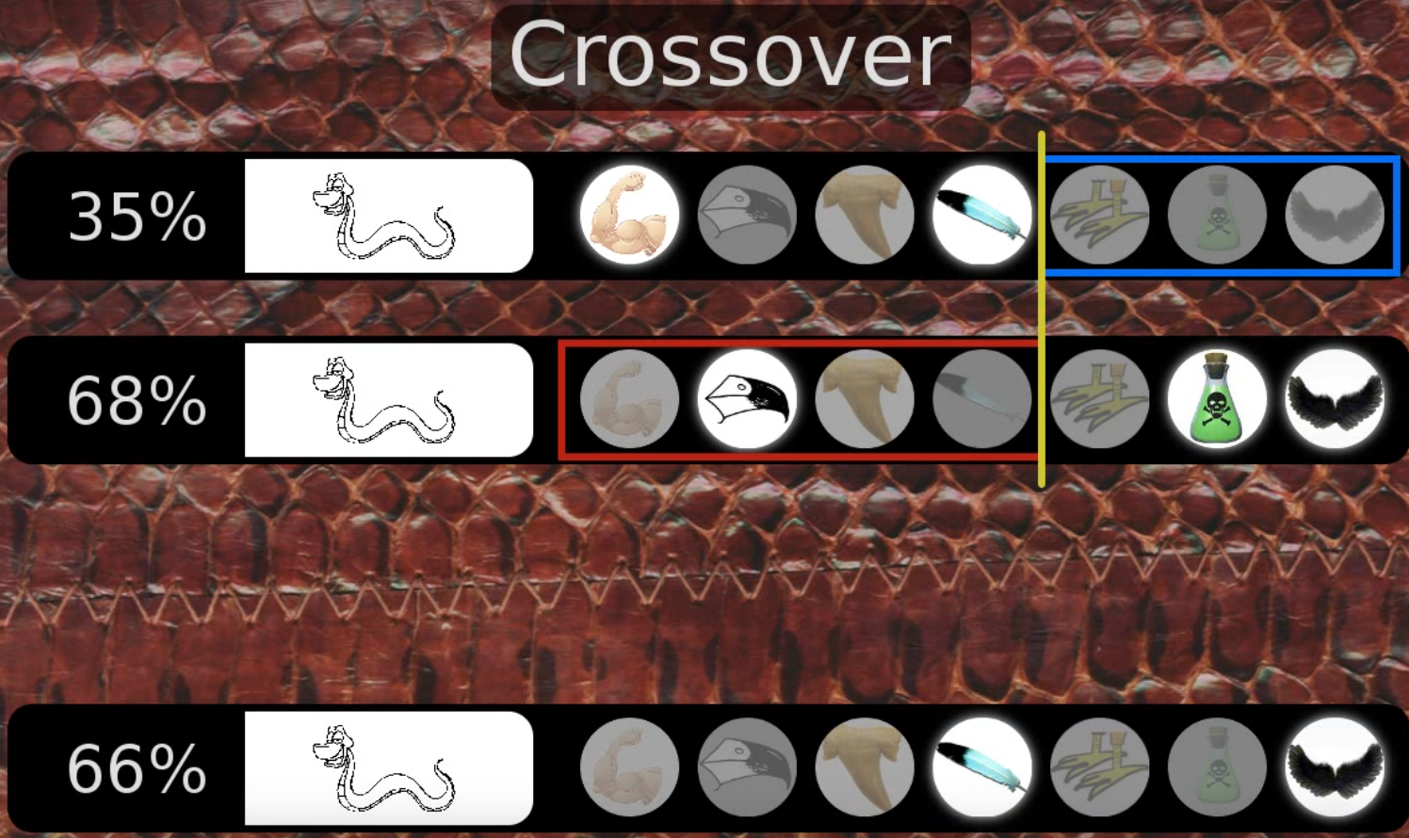

Slide 36
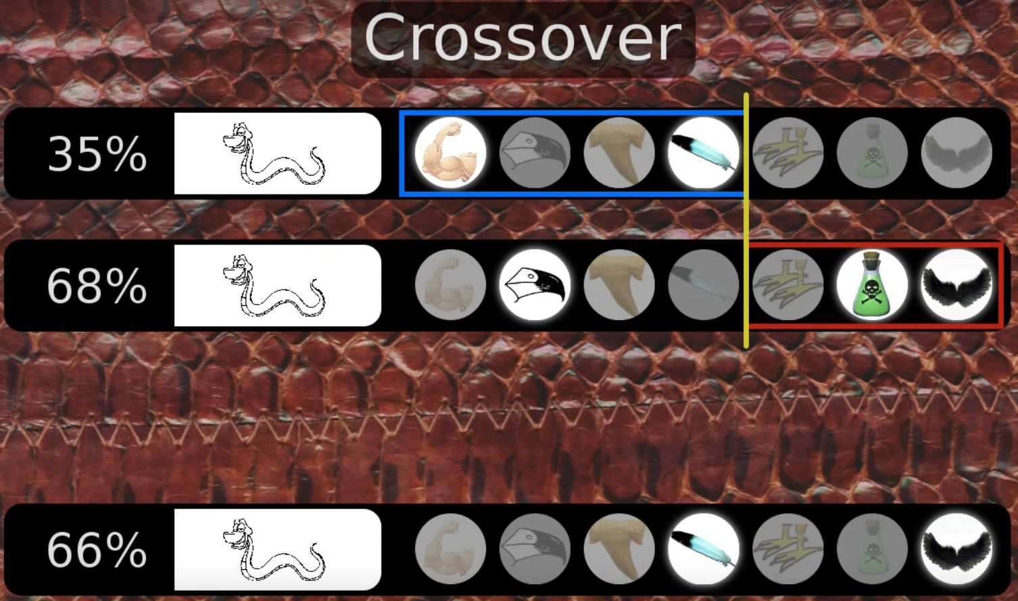

Slide 37
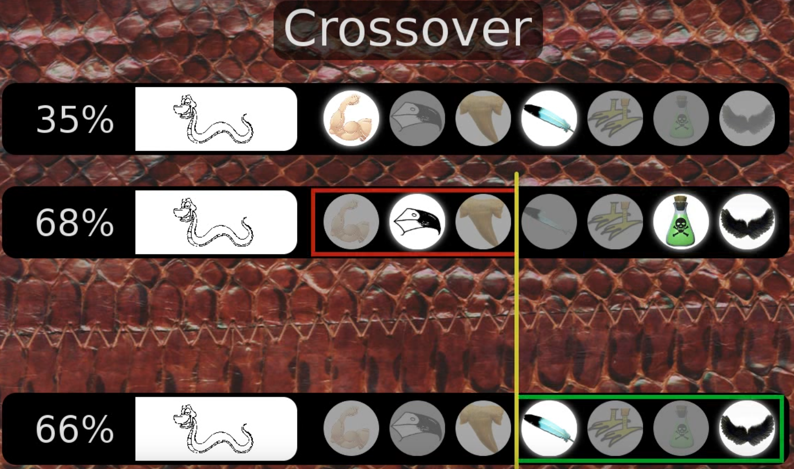

Slide 38
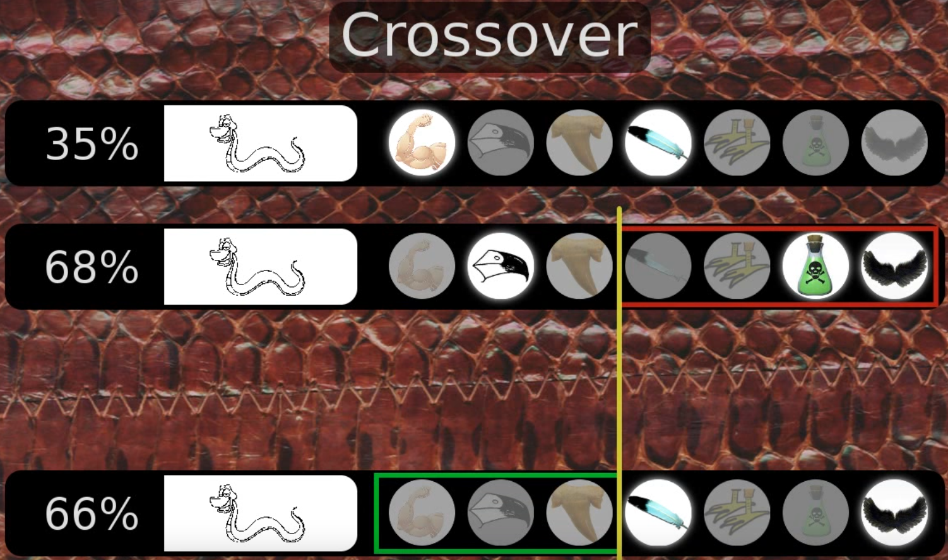

Slide 39
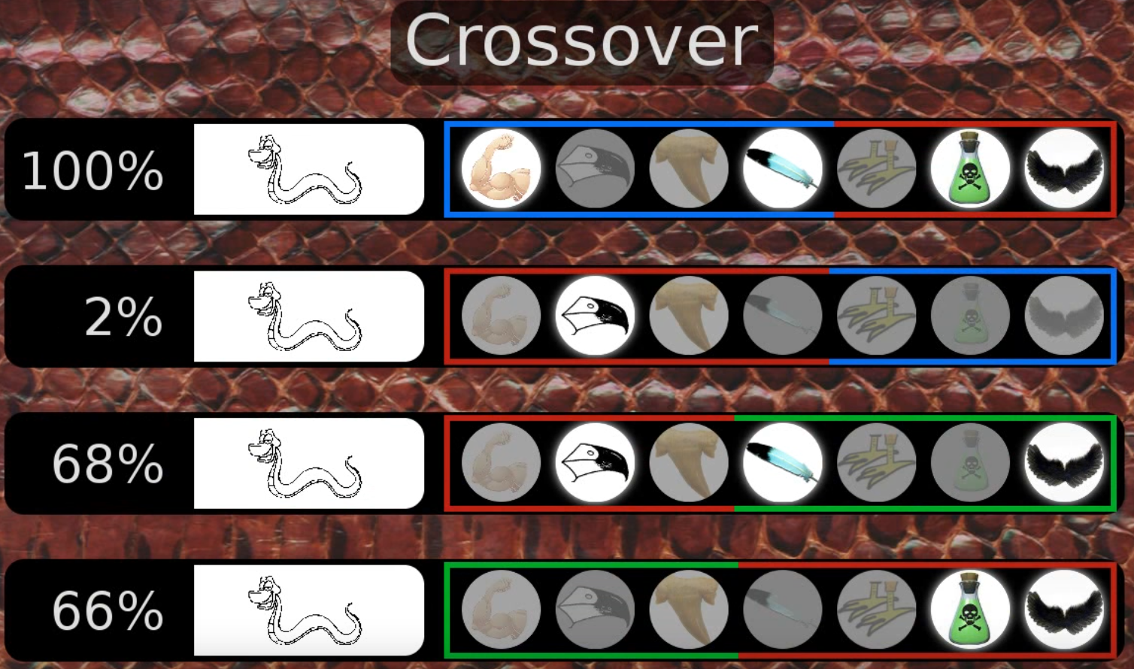

Slide 40
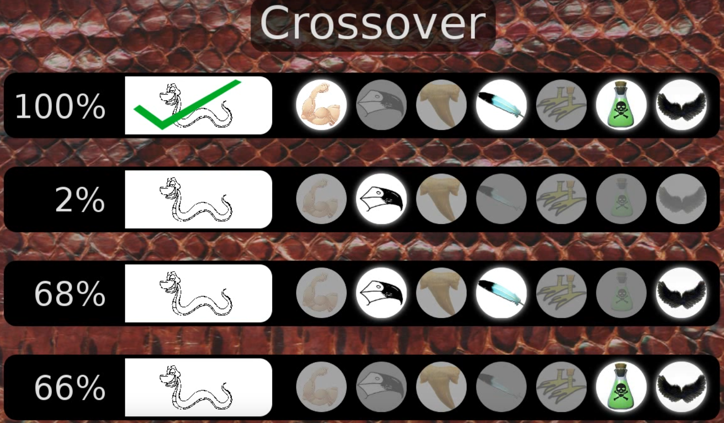

Slide 41
A Simple Example
The Traveling Salesman Problem:
Find a tour of a given set of cities so that
– each city is visited only once
– the total distance traveled is minimized
21

Slide 42
Representation
Representation is an ordered list of city
numbers known as an order-based GA.
1) London
2) Venice
3) Dunedin
4) Singapore
5) Beijing 7) Tokyo
6) Phoenix 8) Victoria
CityList1
CityList2
(3 5 7 2 1 6 4 8)
(2 5 7 6 8 1 3 4)
22

Slide 43
Crossover
Crossover combines inversion and
recombination:
* *
Parent1
Parent2
Child
(3 5 7 2 1 6 4 8)
(2 5 7 6 8 1 3 4)
(5 8 7 2 1 6 3 4)
This operator is called the Order1 crossover.
23

Slide 44
Mutation
Mutation involves reordering of the list:
* *
Before:
After:
(5 8 7 2 1 6 3 4)
(5 8 6 2 1 7 3 4)
24

Slide 45
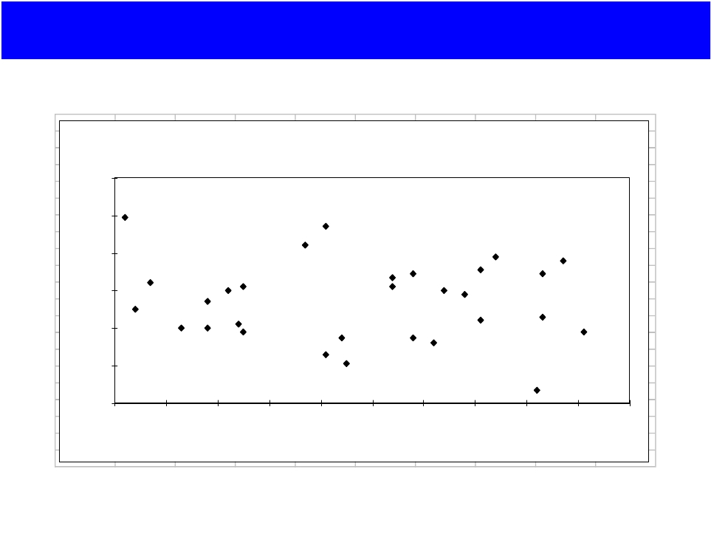
TSP Example: 30 Cities
120
100
80
60
40
20
0
y
0
10
20
30
40
50
60
70
80
90
100
x
25

Slide 46
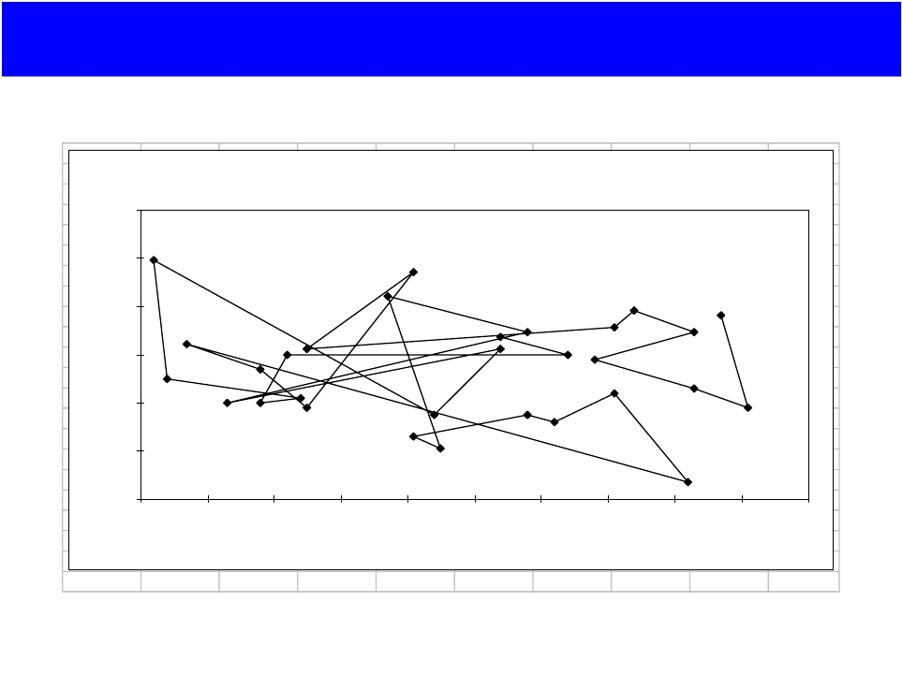
Solution i (Distance = 941)
TSP30 (Performance = 941)
120
100
80
60
40
20
0
y
0
10
20
30
40
50
60
70
80
90
100
x
26

Slide 47
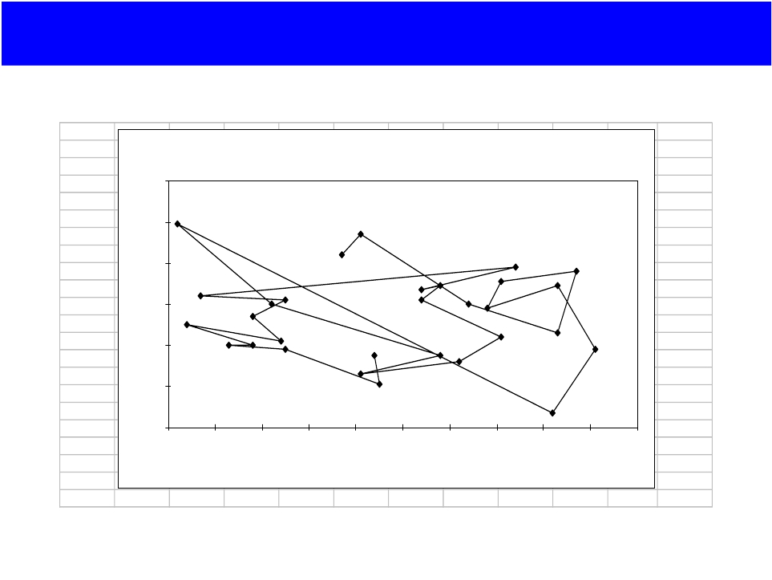
Solution j (Distance = 800)
44
62
69
67
78
64
62
54
42
50
40
40
38
21
35
67
60
60
TSP30(Performance =800)
120
100
80
60
40
20
0
y
40
0
10
20
30
40
50
60
70
80
90
100
42
50
99
x
27

Slide 48
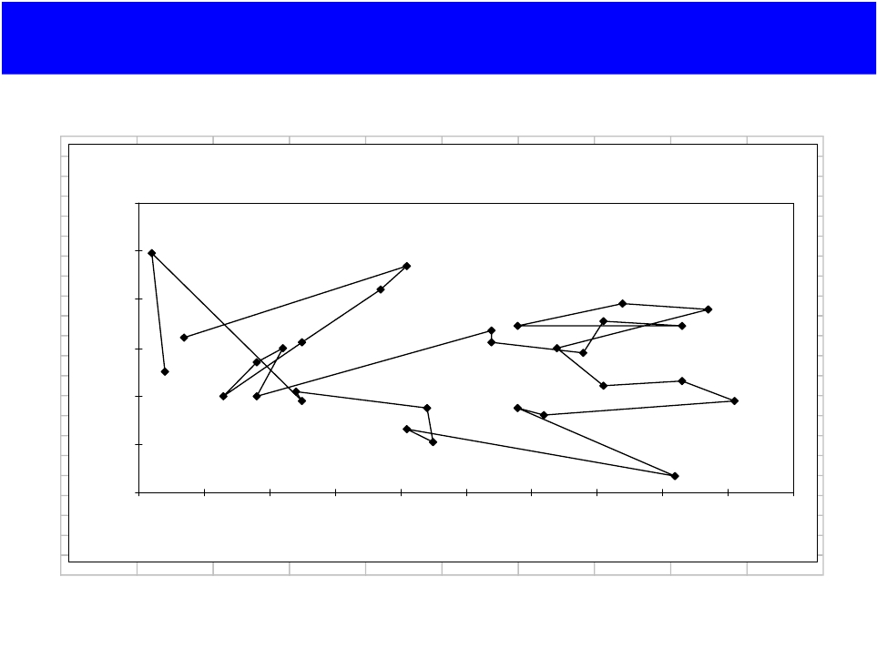
Solution k (Distance = 651)
TSP30 (Performance = 652)
120
100
80
60
40
20
0
y
0
10
20
30
40
50
60
70
80
90
100
x
28

Slide 49
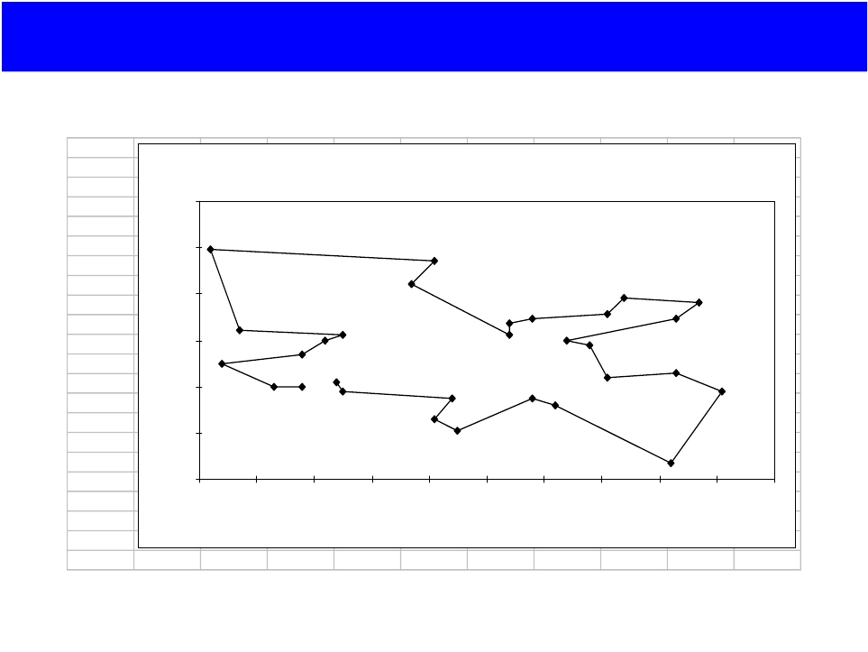
Best Solution (Distance = 420)
42
38
35
26
21
35
32
7
38
46
44
58
60
69
76
78
71
69
TSP30 Solution (Performance = 420)
120
100
80
60
40
20
0
y
67
0
10
20
30
40
50
60
70
80
90
100
62
84
94
x
29

Slide 50
Thank You

